Slide 1
Screen Selector
What is a Screen Selector?
- A Screen Selector is a graphical user interface (GUI) on the screen of the brain that allows for selection of a specific Autonomous route (Sometimes called Autons).
Why use a Screen Selector?
- The use of a Screen Selector reduces the chances of running the wrong Autonomous route and allows for the user to have multiple paths in one program rather than multiple programs for multiple paths.
Match
Skills
Other
Debug
Left HAWP
Set-Up:
Set Facing North,
On edge of tile by match load.
Points: 10
Tab List:
Holds tabs that have their own list of Autons.
- Can be pressed to select tab.
Left HAWP
Left Alt HAWP
Right HAWP
Tab:
Displays a list of Autons.
- Displays a Name
- Changes Color when active
Right Alt HAWP
Full Win Point
Display Window:
Displays currently selected Auton.
Displays Name of Auton
Displays Set-Up Description
Displays Points
Autons:
Upon being selected an Auton will be set and displayed.
Name
Set-Up Description
Points
Callback to Auton
List of Autons:
Groups together Autons in a list.
Can be pressed to select Auton
Resizes to amount of Autons
Notes:
Colors on brain screen selector are the same in code and journal (Don’t change)

Slide 2
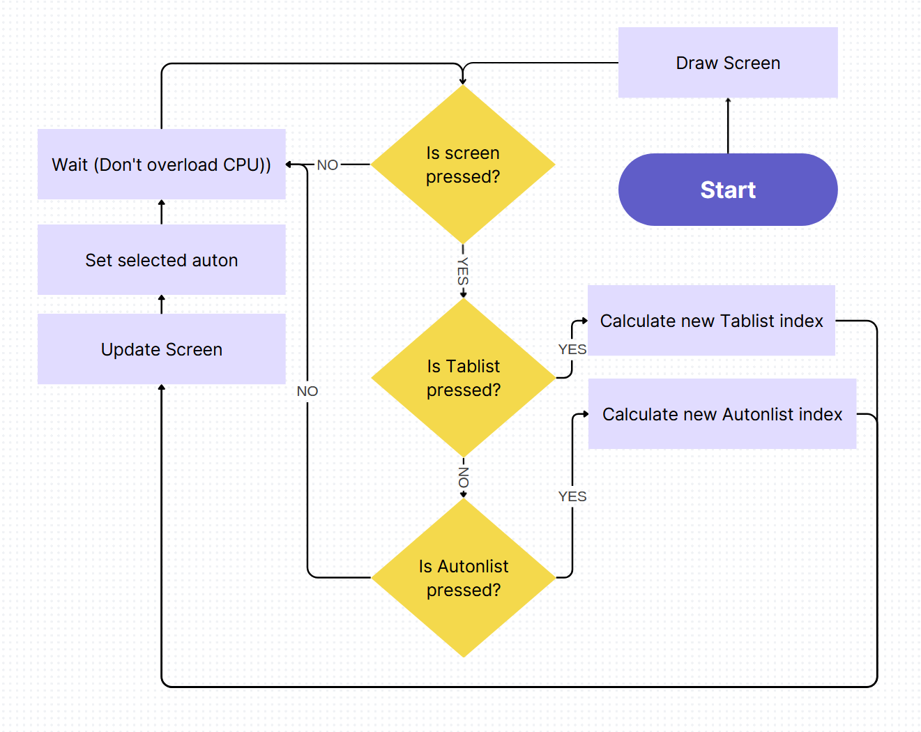
Flow Chart
Notes:
Flow chart is picture from canva.

